Slide 1
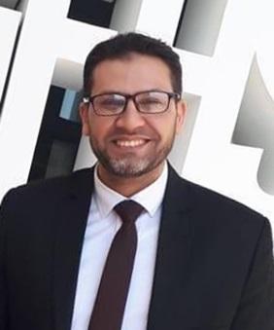
Student attendance system with face recognition using deep learning techniques
‹#›
Presented by
Mohamed Abdelrahman Code: 180113
Mohamed Gamal Code: 180104
Mohamed Essam Code : 180114
Ola Abdallah Code : 180087
Nourhan Mahmoud Code : 180146
Shimaa Mostafa Code : 180072
Supervised by
Dr. Ahmed Elngar
Faculty of Computers and Artificial Intelligence
Beni-Suef University
Computer Vision: Student Attendance system. Sunday 28-11-2021

Slide 2
Outline
Face recognition
Literature review
Proposed system
Implementation
Experimental results
Advantages & Disadvantages

Slide 3
Problem Definition
Conventional methods used for taking attendance had demerits such as; they were time consuming, hard to maintain, false calling of attendance, etc.
The intervention of the students and teachers in the conventional system is very much prone to error and may be biased due to different factors.
Trying to eradicate these errors prevailing in the conventional systems is clearly very tough or next to impossible.
Some productive purpose is wasted.

Slide 4
Objectives
To make use of modern techniques for the purposes of making an attendance generating system.
To make a system that can detect the faces from the live video.
To make a system which is capable of comparing and matching detected faces of students to those on database in the system.
Challenges:
Recognizing the student from one image at any position or age.

Slide 5
Face recognition

Slide 6
What is Face recognition
Facial recognition is a type of computer vision technology that is able to identify people’s faces within digital images.
One of the popular biometric process which is widely used in surveillance, security, criminal identification, etc.
General process comprised of detection, alignment, feature extraction, and a recognition task It has 4 steps which are :
Face Detection
Data Gathering
Data Comparison
Face Recognition

Slide 7
What is Face recognition (cont.)
General face recognition pipeline:
Face detection
Facial landmark detection
Face alignment
Feature extraction
Feature comparison and matching

Slide 8
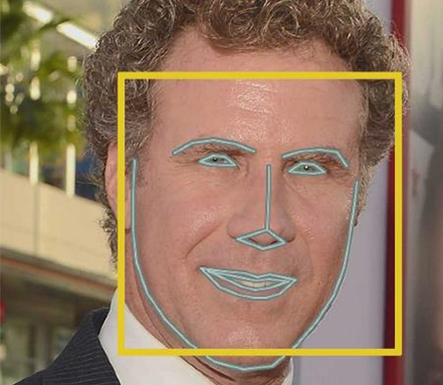
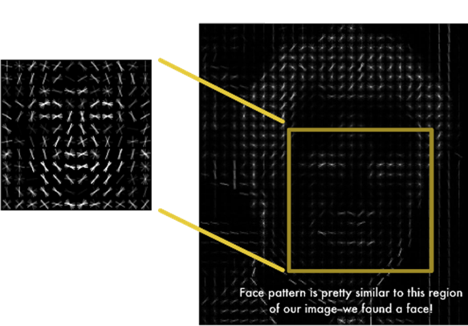
Face detection
Identify which parts of an image or video should be focused.

Slide 9
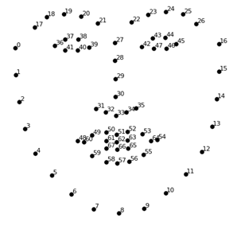

Landmark detection
Identify the locations of the facial key landmark points on facial images or videos

Slide 10
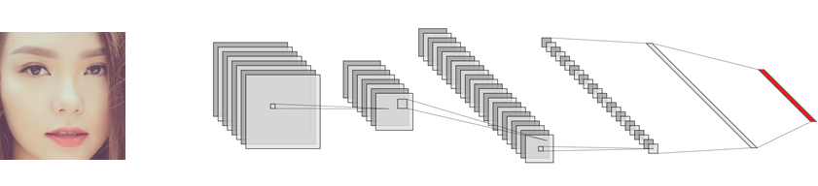
Face recognition
Verifying face with extracted features
Input image:
- High-dimensional
- Rich detail
Feature vector:
- Low-dimensional
- Representative

Slide 11
Literature review

Slide 12
Literature Survey
Comparison for existing face detection algorithms
Comparison for existing face recognition algorithms
Experiments based on labeled faces in the wild (LFW) Dataset

Slide 13
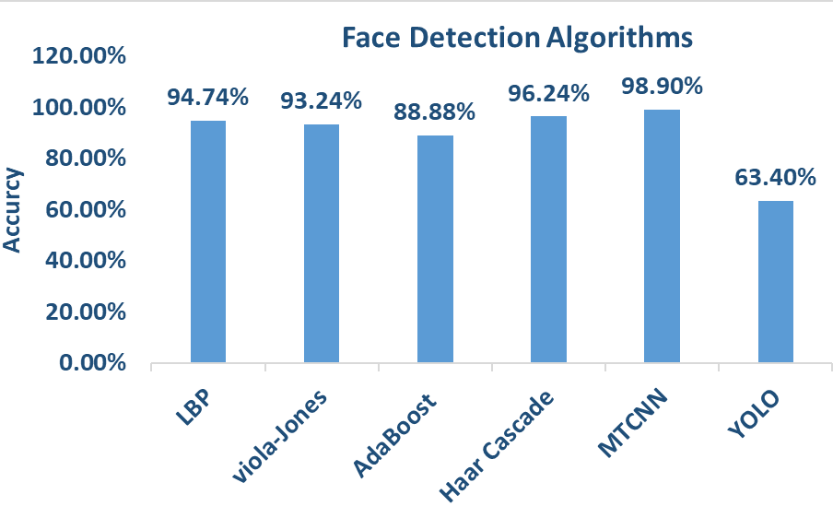
Face Detection Algorithms Survey
MTCNN
viola-Jones
AdaBoost
Haar Cascade
LBP
YOLO
https://paperswithcode.com/sota/face-verification-on-labeled-faces-in-the

Slide 14
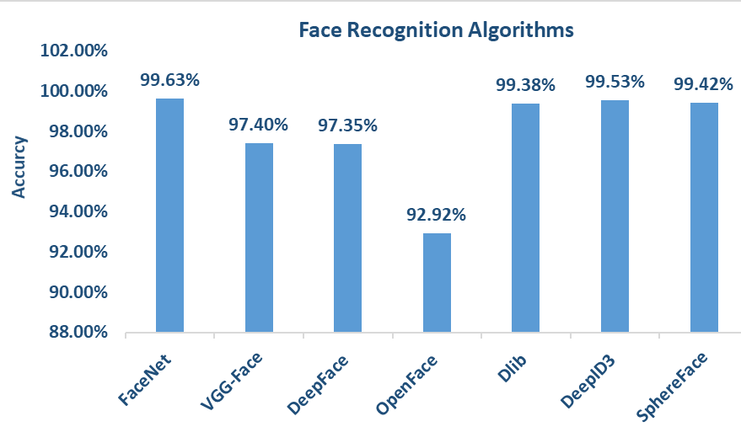
Face Recognition Algorithms Survey
FaceNet
VGG-Face
DeepFace
OpenFace
Dlib
DeepID3
SphereFace

Slide 15
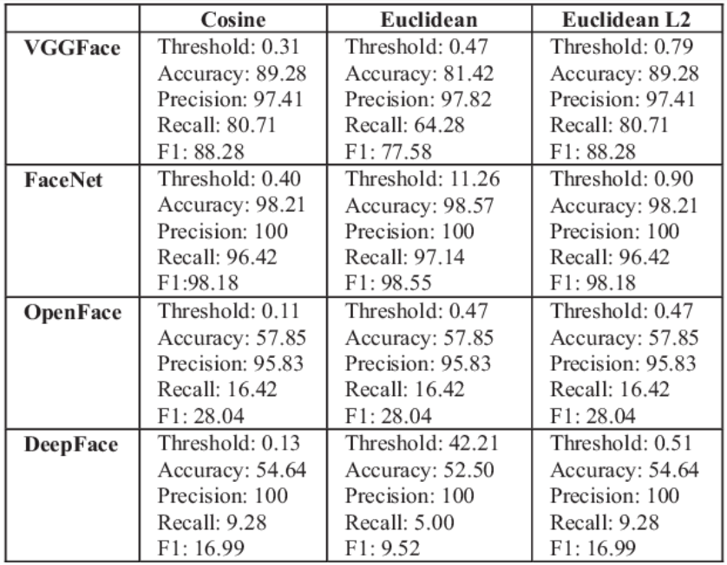
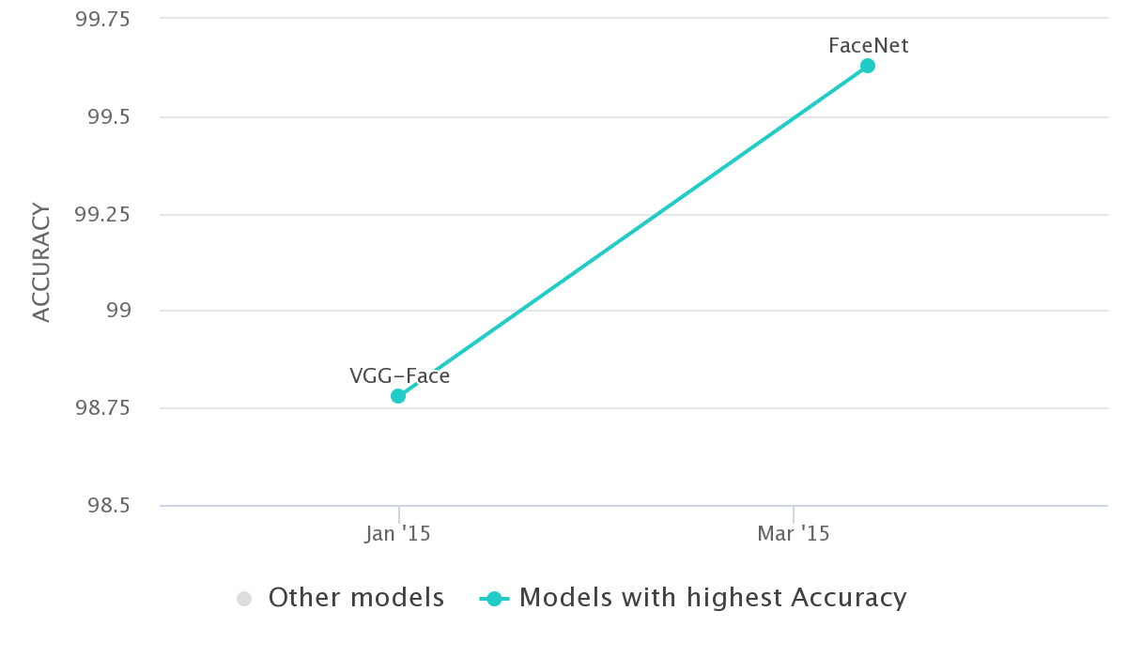
Face Recognition Algorithms

Slide 16
Proposed system

Slide 17
Methodology
We built our model based on deep convolutional neural network (DCNN) for the following tasks:
Face detection
Multitasking Cascading Convolutional Networks (MTCNN)
Face recognition
FaceNet model
ResNet model (Inception-ResNet-v1 architecture)
Face Verification
Binary classification

Slide 18
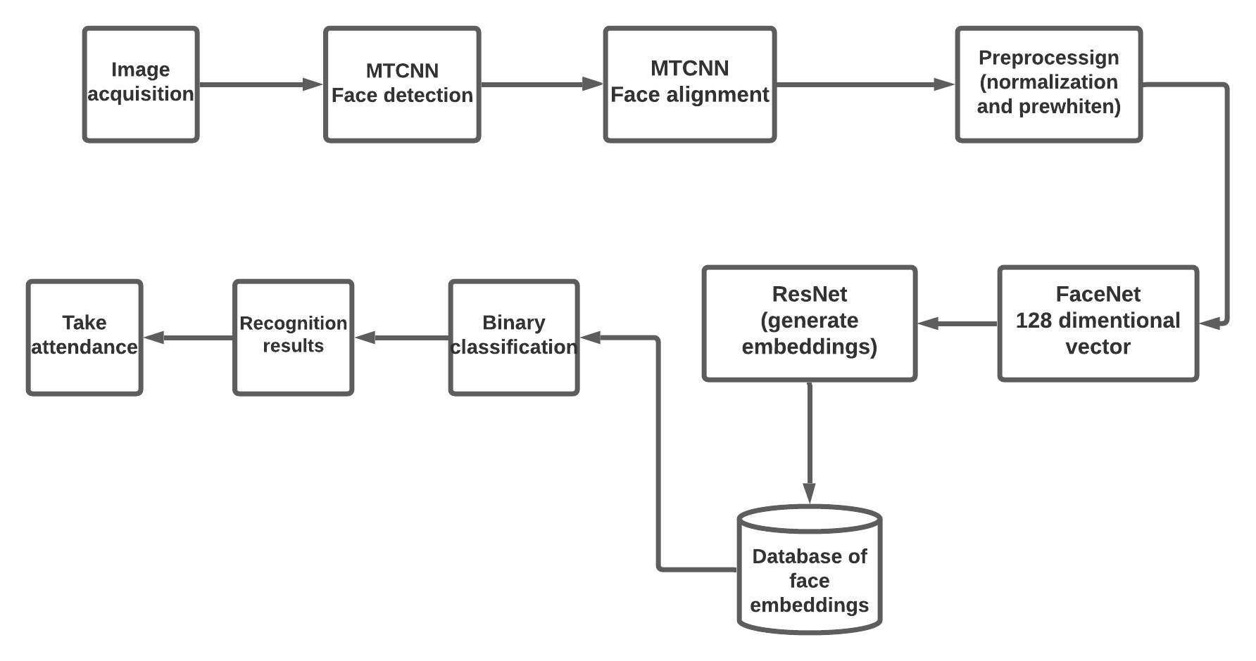
System pipeline

Slide 19
Convolutional neural network (CNN)
Convolutional layer
Max-pooling layer
Fully connected layer

Slide 20
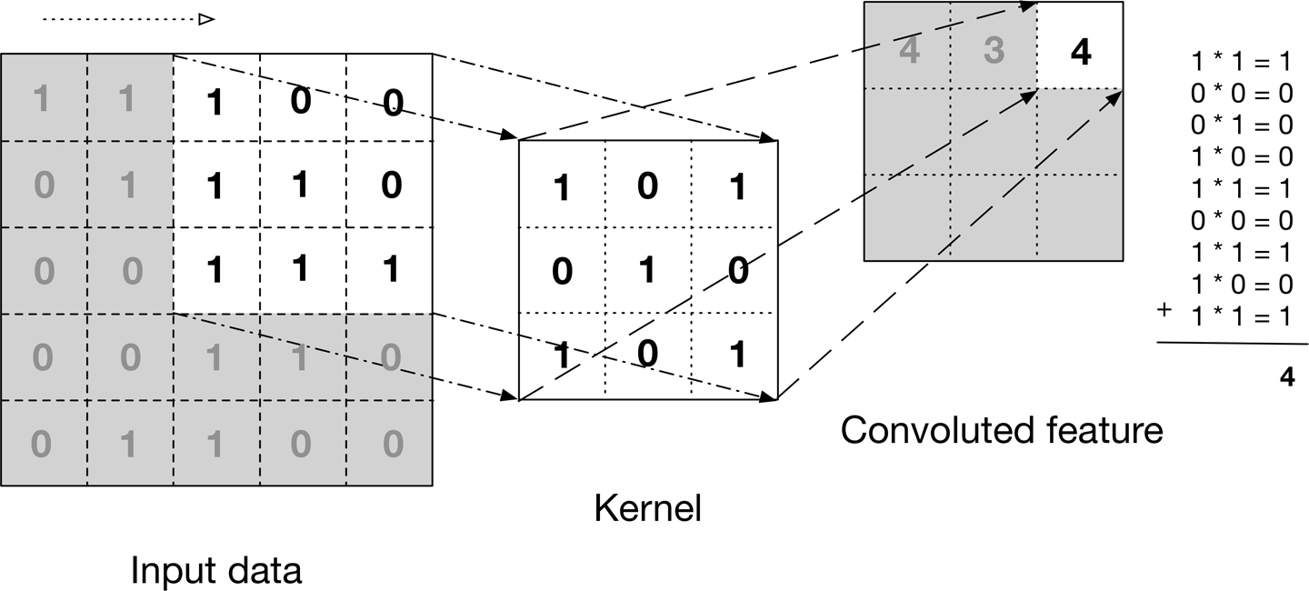
Convolution layer
Apply filters
Extract features

Slide 21
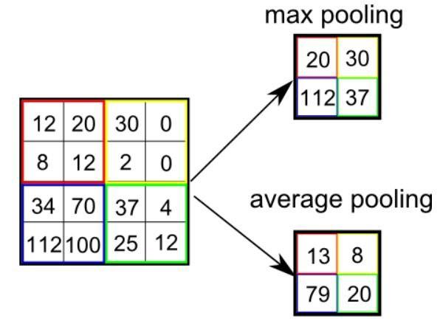
Max-pooling layer
Reducing the spatial size of the Convolved Feature.
This is to decrease the computational power required to process the data by reducing the dimensions.
Pooling average pooling
Max pooling.

Slide 22
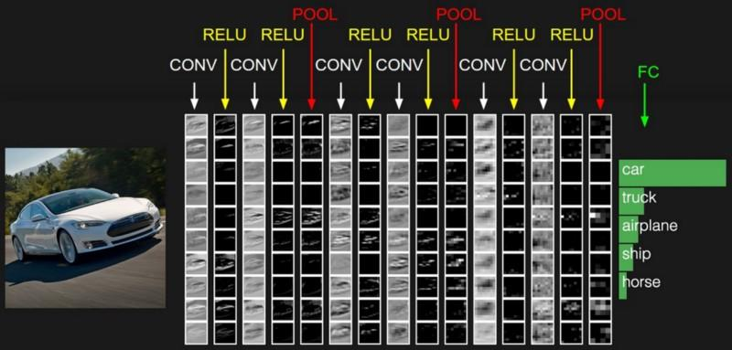
Fully connected layer
This layer is a regular neural network layer that takes input from the previous layer and computes the class scores and outputs the 1-D array of size equal to the number of classes.

Slide 23
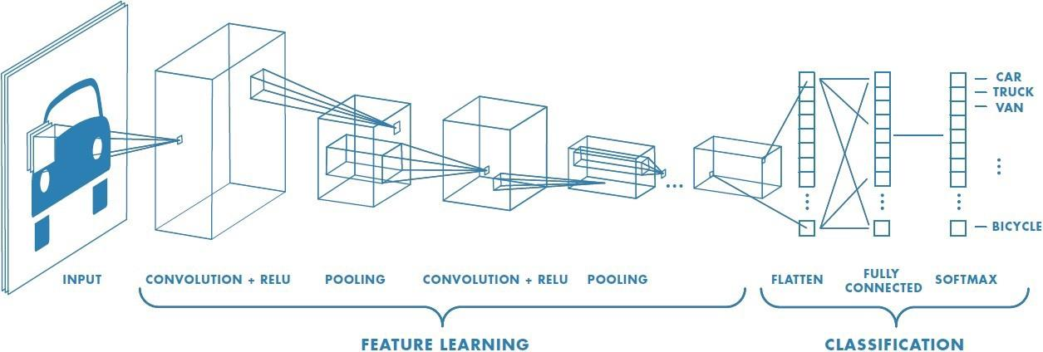
CNN Full Picture

Slide 24
MTCNN
MTCNN uses three separate CNN models (P-Net, O-Net, R-Net) to detect faces.
The MTCNN feature descriptor mainly includes three parts:
Face/non-face classifier
this is a binary classification problem that uses cross-entropy loss:
Bounding box regression
is a common technique for predicting the localization of boxes when the goal is to detect an object of a predefined class, in this case, the face.
Landmark location
There are five landmarks: left eye, right eye, nose, left mouth corner, and right mouth corner

Slide 25
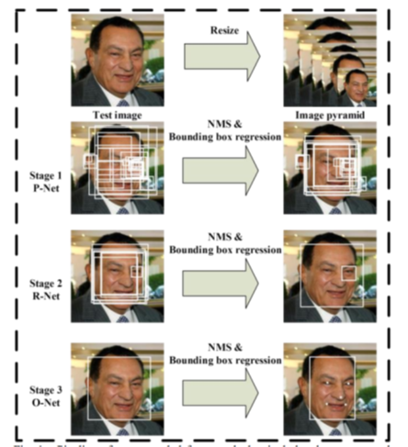
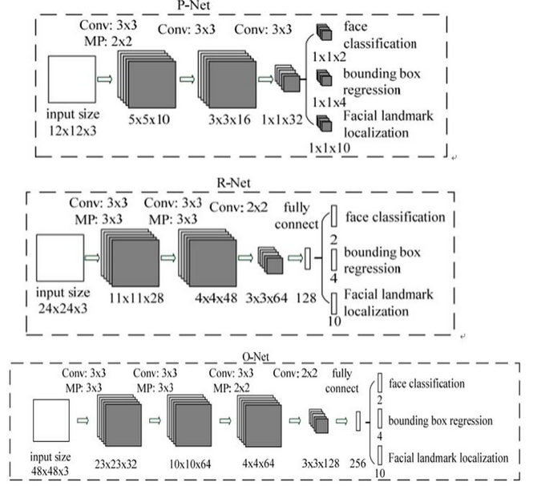
MTCNN (cont.)

Slide 26
MTCNN (cont.)
The Proposal Network (P-Net)
Used to obtain the candidate windows and their bounding box regression vectors.
After obtaining the bounding box vectors, some optimizations are made to merge the overlapping regions using Non-Maximum Suppression (NMS)
The Refine Network (R-Net)
Reduces the number of candidates, calibrates using bounding box regression, and employs NMS to integrate overlapping candidates
The Output Network (O-Net)
Similar to the R-Net stage, but this output network is intended to describe the face in more detail and to output the positions of the five facial features of the eyes, nose and mouth.

Slide 27
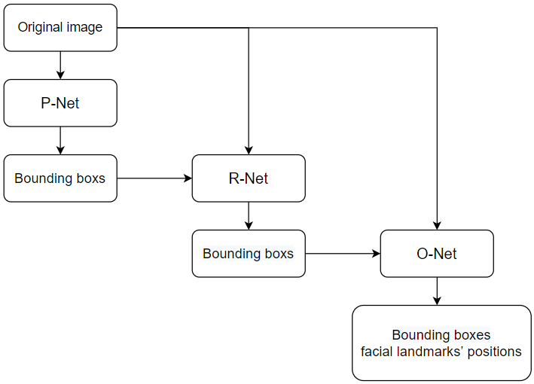
MTCNN Full Picture

Slide 28
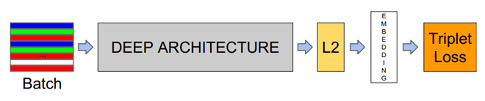
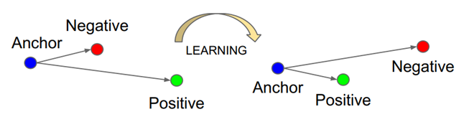
Face recognition based on FaceNet
FaceNet method based on learning a Euclidean embedding per image using DCN.
The network is training such as L2 distances in the embedding space.
Face verification - thresholding the distance between two embeddings
Triplet loss:
Minimizes the distance between an anchor and a positive
Maximizes the distances between the anchor and a negative

Slide 29
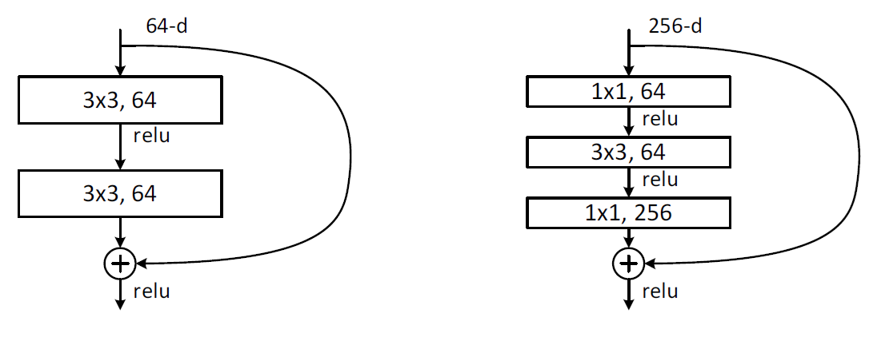
ResNet
A specialized network introduced by Microsoft.
The ResNet idea could easily expanded into convolutional model.
Full ResNet architecture:
Stack residual blocks
Every residual block has two 3x3 conv layers

Slide 30
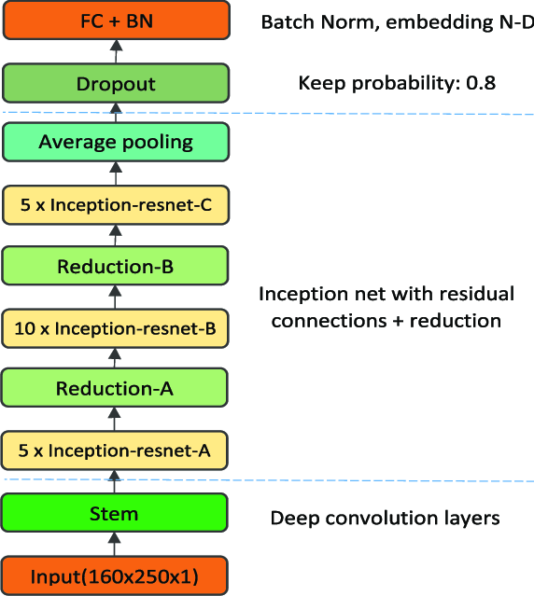
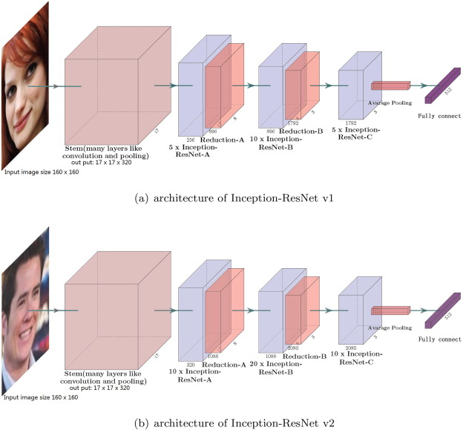
Inception Resnet V1
InceptionResNetv1 one of the best pre-trained models working on face recognition so, we will use this model that was trained on huge dataset of faces

Slide 31
Implementation

Slide 32
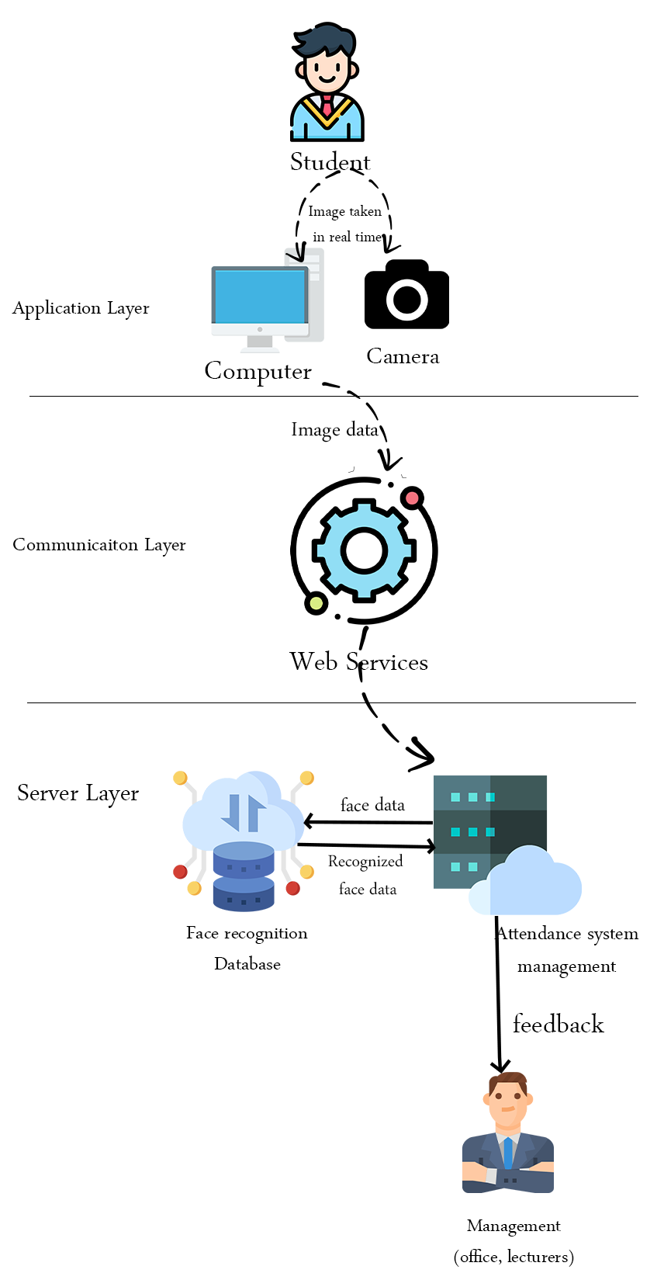
Web Application Architecture
The main components of the application are:
1) Front-End Interface (Camera)
2) Server
3) CNN Model
4) Database
5) End Result (Display Screen)

Slide 33
Implementation
The system is developed using the following tools:
Python programming language
TensorFlow framework
Keras
Database (SQLlite)
OpenCV
Flask
ORM (SQLAlchemy)

Slide 34
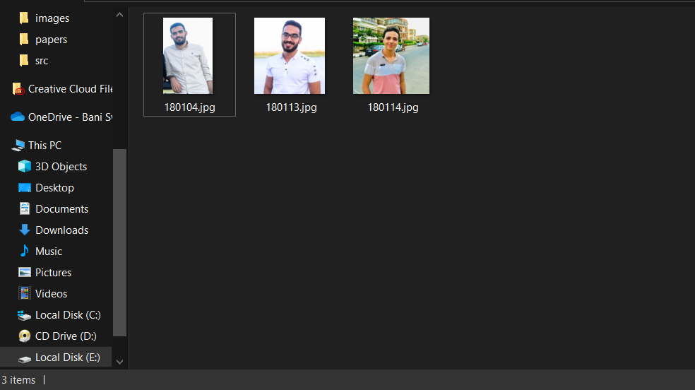
Implementation (Con.)
Data collection
Just put student image following with student code into the images folder.

Slide 35
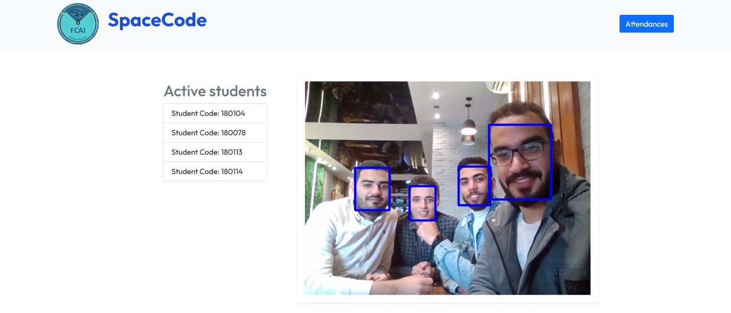
Implementation (Con.)
Real time video processing
The system will recognize you as attend once you appeared.
It doesn’t take it again until pass 2 hours for last attended record.

Slide 36
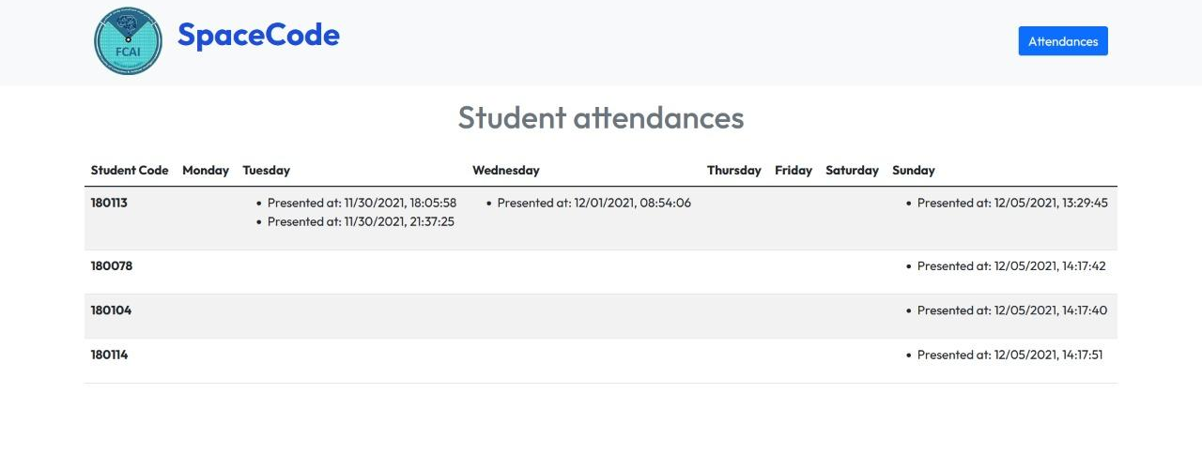
Implementation (Con.)
Recording attendances

Slide 37
Experimental results

Slide 38
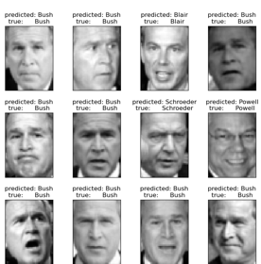
Experimental results
Labeled Faces in the Wild (lfw) Dataset example

Slide 39
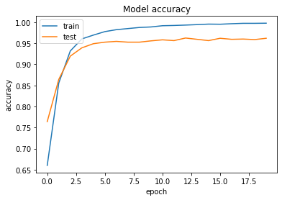
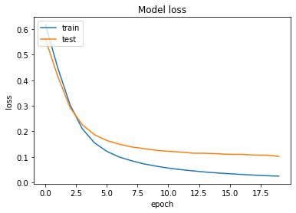
Experimental results (Con.)
Accuracy & Loss : The below graphs represents the accuracy and loss for the training and testing data.

Slide 40
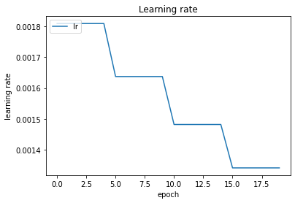
Experimental results (Con.)

Slide 41
Advantages & Disadvantages

Slide 42
Advantages & Disadvantages..
Advantages | Disadvantages
High recognizing accuracy from one image. Management system build based on web application | Need a lot of computation resources.

Slide 43
Conclusion
We proposed a student’s attendance system using deep facial recognition.
Face detection and recognition are performed by convolutional neural network models MTCNN and FaceNet, also we will make use of Inception ResNetV1 pre-trained model in our project to extract feces features before classifying these features using CNN.
The main feature of face recognition, regardless of the high accuracy in recognizing faces, is that we need only one picture for every student to enable our model from recognizing the student. Based on the results, it can be concluded that proposed architecture presents a good solution for managing the attendance of students in classrooms.

Slide 44




Thanks and Acknowledgement
Thank you
‹#›
‹#›
Dr. Ahmed A. Elngar (Ph.D) Assistant Professor Faculty of Computers & Artificial Intelligence
Beni-Suef University, Beni Suef City, office box # (62511),, Egypt
Founder and Chair of the Scientific Innovation Research Group (SIRG)
Managing Editor in Journal of CyberSecurity and Information Management (JCIM)
Email: elngar_7@yahoo.co.uk
Email: ahmedelnagar@fcis.bsu.edu.eg Mobile : (+2)01007400752
www.sirg.club

